Slide 1

Project Name Student’s CGPA Calculator Software
Course Title: Software Development with Java
Course Code: CSE-200
Supervised By :
Md. Mynul Hasan
Assistant Professor
Department of CSE, CUET
&
Animesh Chandra Roy
Assistant Professor
Department of CSE, CUET
Team Leader:
Salman Farsi(1804102)
Team Members:
Mirza Asif Razoan(1804093)
Arat Ibne Golam Mowla(1804117)
Riad Hossain (1804071)

Slide 2
Contents
Introduction
Applications
Motivations
Module
Flowchart
Conclusion

Slide 3
Introduction
CGPA calculator is a software designed for calculating the CGPA of students.
Once they provide necessary information to use this software they will be able log into the system. But if they don’t have an account, we kept an option to sign up. Also software users or visitors can visit our site without logging in.
So, we have added a guest mode option as well by clicking on which, one visitor can directly using this software.

Slide 4
Applications
The main purpose of our CGPA calculator is to help the students to calculate CGPA by entering their marks and course info. Normally one has to manually decide the percentage of marks he got in total and then would need to find the grade. This software overcome these limitations.

Slide 5
Motivations
Calculating the grade of a student is very necessary for any academic system.
Sometimes it is required to input the marks and see the grades. In other cases total CGPA may also be demanded. So our system was designed keeping that idea in mind that sometimes some students or any academic admin may input only the marks of the courses and as a result of that they may want to see the grade of the courses along with the total CGPA.

Slide 6
MODULES
UI Design and Layout
JFrame Connection
Java Coding Completion for input and result
Final Output

Slide 7
Flow Chart
UI DESIGN AND LAYOUT
JFrame Connections
Java Coding Completion for input
Final Output

Slide 8
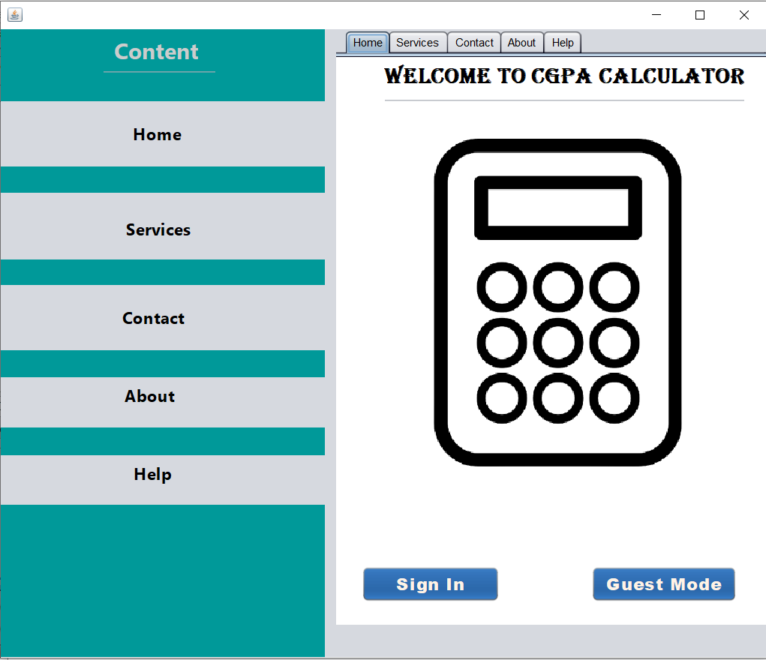
MODULE – 01. UI DESIGN AND LAYOUT
Home: First option in the menu bar is our home page which has two buttons,
one is for sign in and another is for guest mode. Sign In button is linked with sign in
page and guest mode is linked with input page .

Slide 9
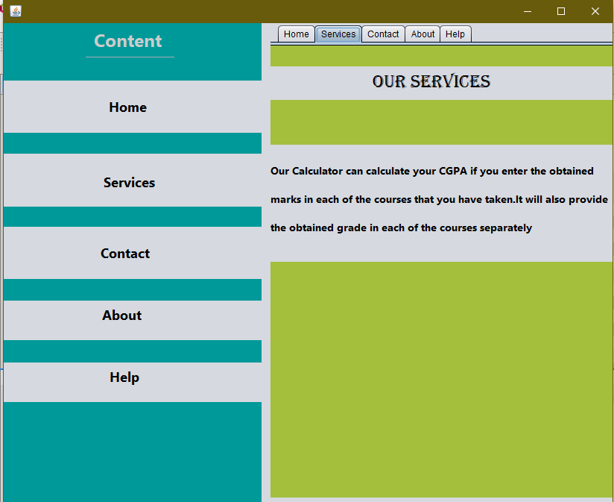
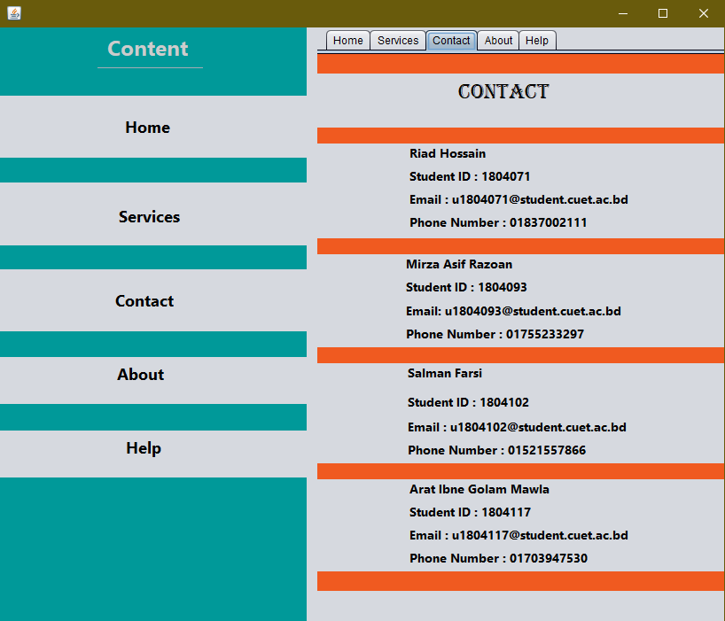
Services: This page briefly describes about the service that a user can get from our software. Contact: From this JPanel user can see who we are in the backend who designed this software for user’s service.

Slide 10
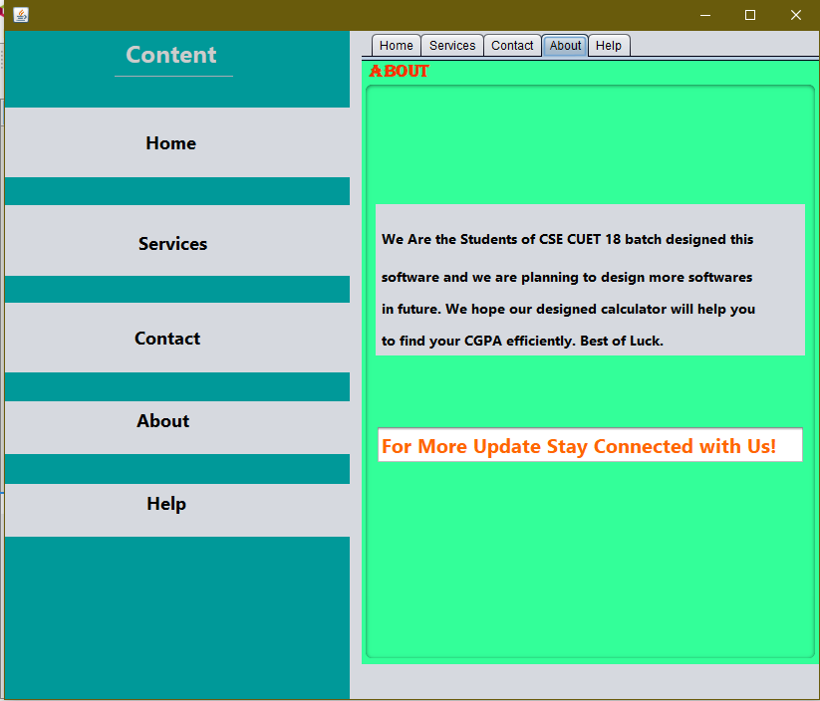
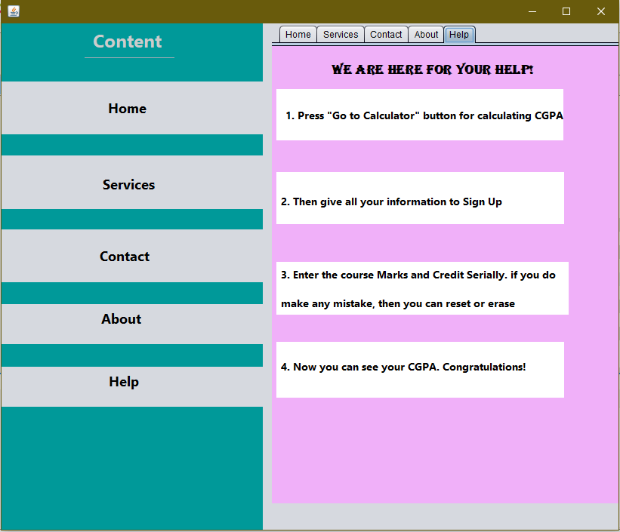
About: This JPanel describes about the software and the description of backend team. Help: This is final Jpanel in this page which is designed to help the user by giving them the step to calculate their CGPA.

Slide 11
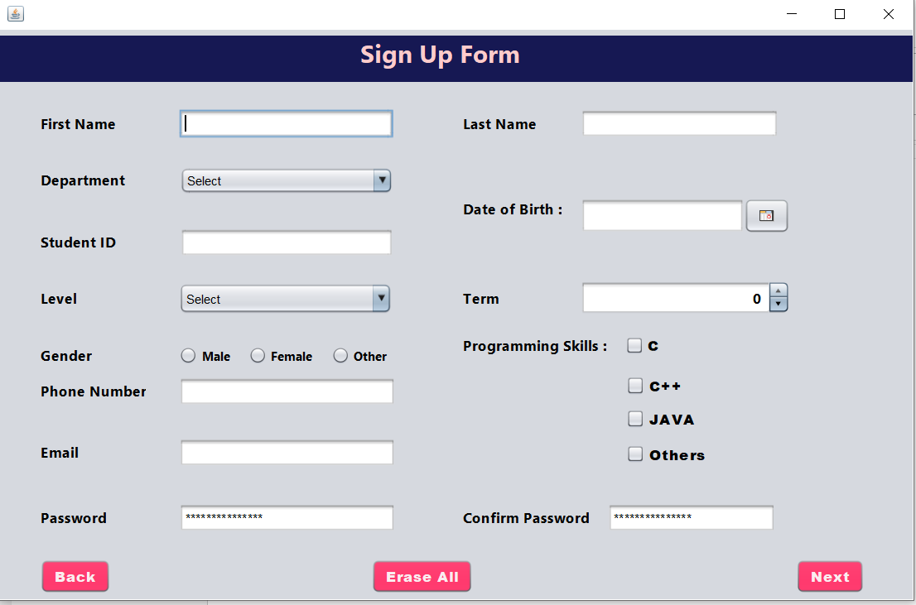
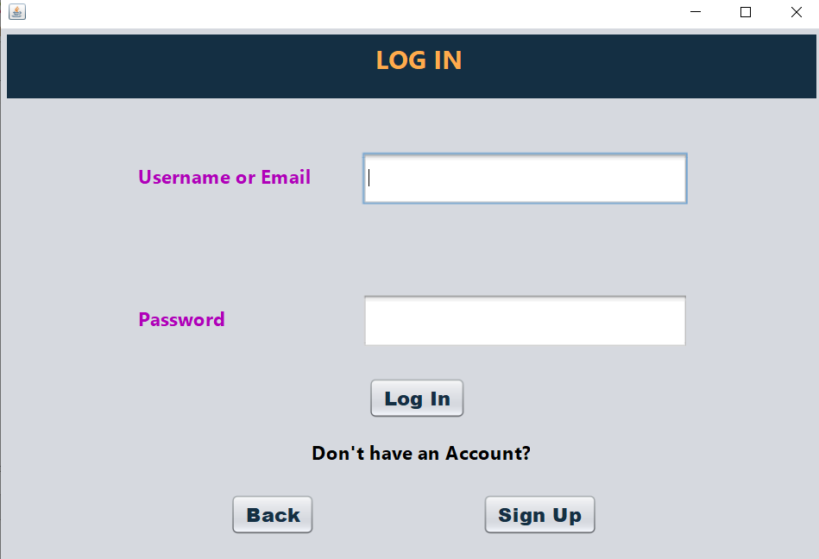
Log In: A user can log in to the software by giving the username or email along with the password. So for username and password we used two text fields. One confirmation button named ‘next’ and another ‘back’ button is used to go to the previous page. Sign Up: If a user don’t have an account, then he/she have to sign up into the software. Giving the required information a user can complete the registration or sign up part. For this ,We use different type of swing components.’ Erase All’ button is used to erase all the information provided.

Slide 12
Swing Components
javax.swing.JTextField : Name, First Name, Last Name, Student ID, Phone, Email
javax.swing.JComboBox : Department, Level
javax.swing.JSpinner : Term
javax.swing.JCalendar : Date of Birth
javax.swing.JRadioButton : Gender
javax.swing.JCheckbox : Programming Skills
javax.swing.JPasswordField : Password and Confirm Password
javax.swing.JSeparator : To separate the heading and input field

Slide 13
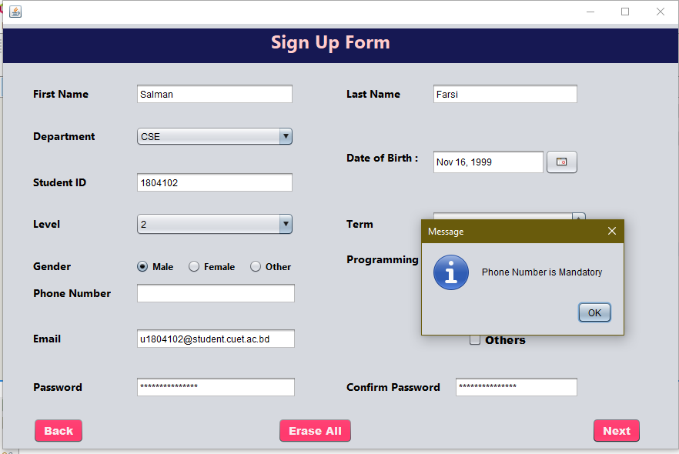
Dialogue Box If any information is missing then a Dialogue Box will show error message that we didn’t give input to a text field.

Slide 14
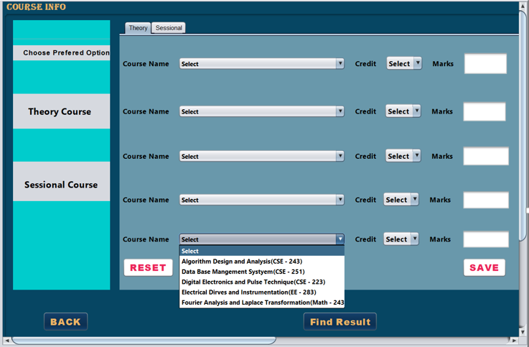
Input: in the input page we have used two separate jpanel in one jframe . One jpanel is for taking input for theory courses and another jpanel is for used for taking input for sessional courses. User will choose course name from the course name combo box as well as credit . This procedure is followed for both theory and sessional.

Slide 15
Swing Components
javax.swing.JComboBox : Theory course Name, Credit
javax.swing.JTextField : Theory course marks
javax.swing.JComboBox : Sessional Course Name, Credit
javax.swing.JTextField : Sessional Marks
javax.swing.JScrollBar : we used to scroll the page to go from top to bottom or go left to right.

Slide 16
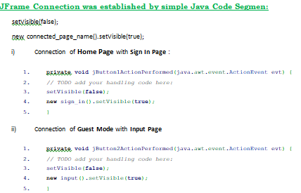
MODULES – 02. JFrame Connections
JFrame is a top-level container that provides a window on the screen. In this module, we connected our JFrames with each other. And created a navigation.

Slide 17
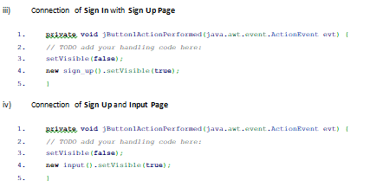
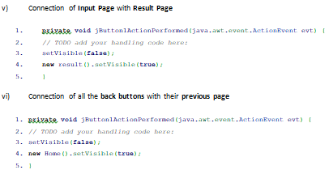

Slide 18
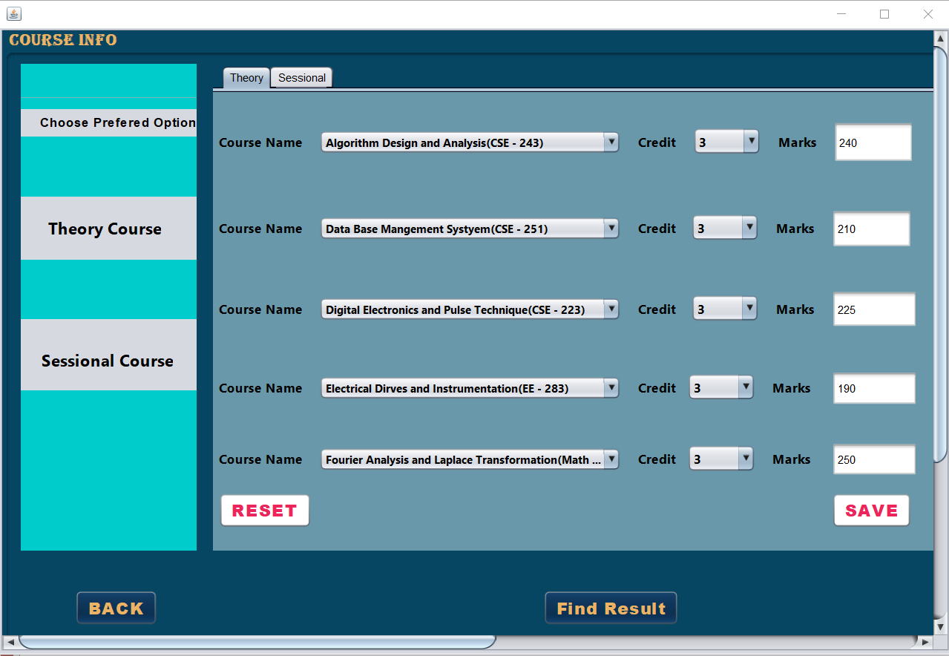
MODULES – 03. Java Coding Completion for input
Input Given For Theory Courses:

Slide 19
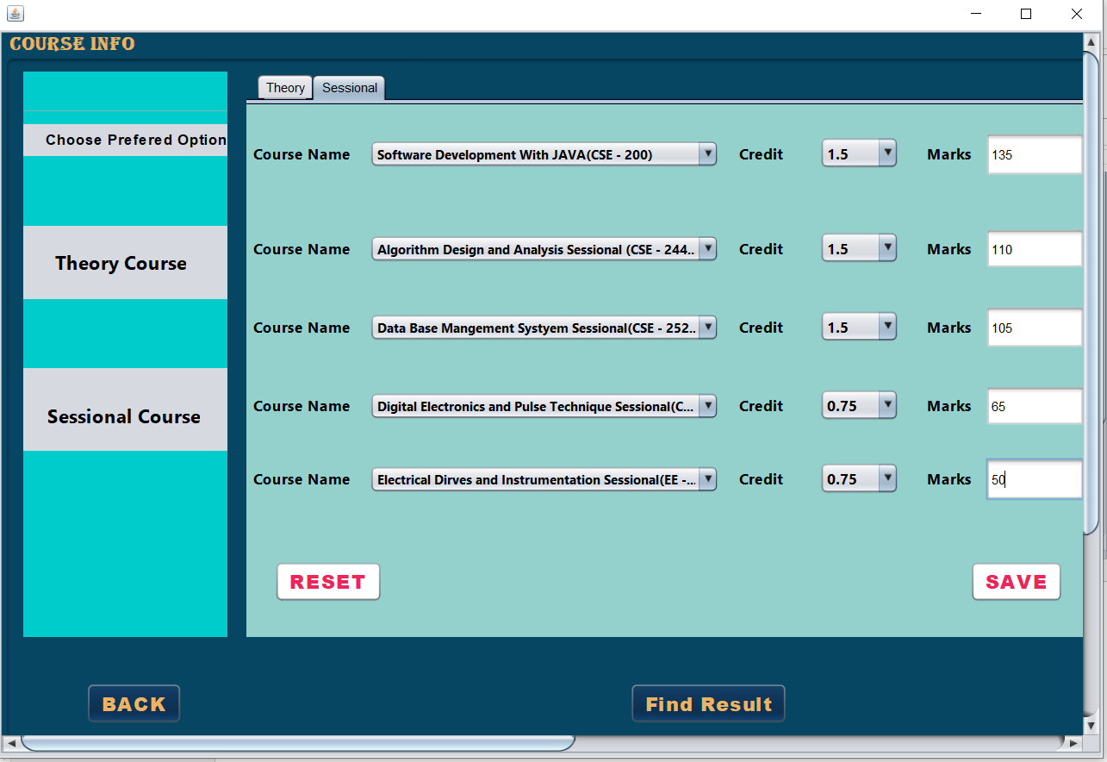
Input Given For Sessional Courses:

Slide 20

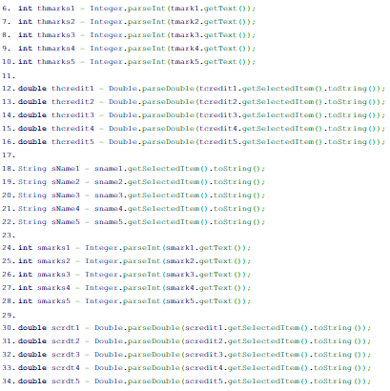

Slide 21
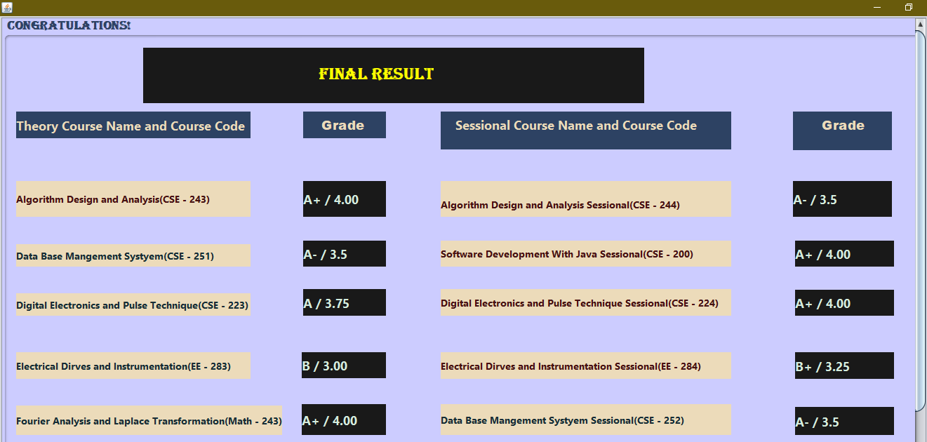

MODULE – 04. Final Output:

Slide 22
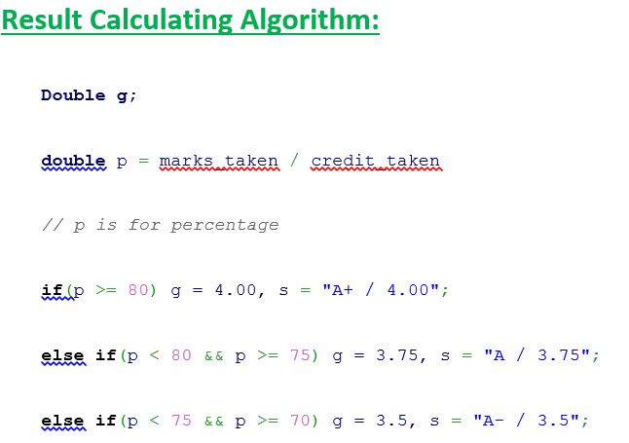
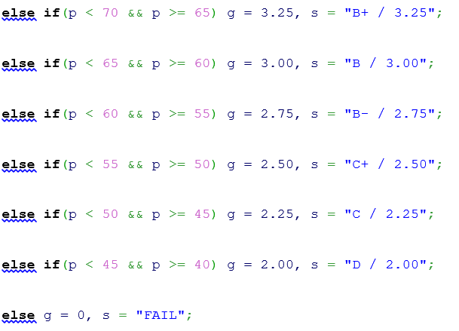
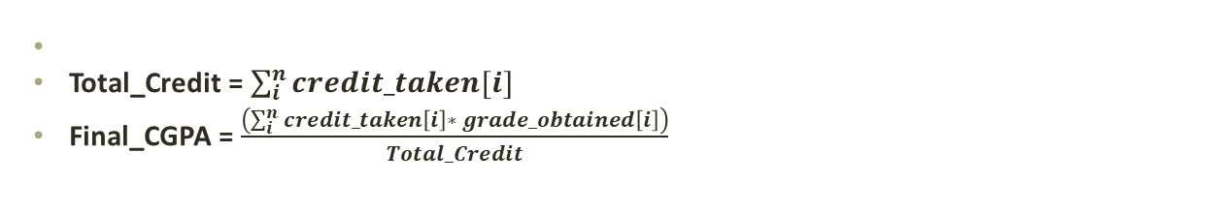
Equation & Algorithm
Total_Credit = $\sum_{i}^{n}{credit_taken[i]}$
Final_CGPA = $\frac{\left(\sum_{i}^{n}{credit_taken\left[i\right]∗ grade_}obtained\left[i\right]\right)}{Total_Credit}$

Slide 23
Conclusion
Our CGPA calculator will hopefully help a lot of students to calculate their CGPA without any tire. In near future we are planning to add some more feature. While designing this software, we learned how to use multiples jframe and use them to design a layout. We understood the logic behind taking input from text field and how to send data from one jframe to another jframe. And obviously how to show the data in different output format as well as changing color of the text, background etc. Finally, it was a very interesting and educative project so far. We really enjoyed it.

Slide 24


